Slide 1




PREMIUM SUITES FAMILY SUITES JACUZZI SUITES
Milestone Project Hotel itc

Slide 2

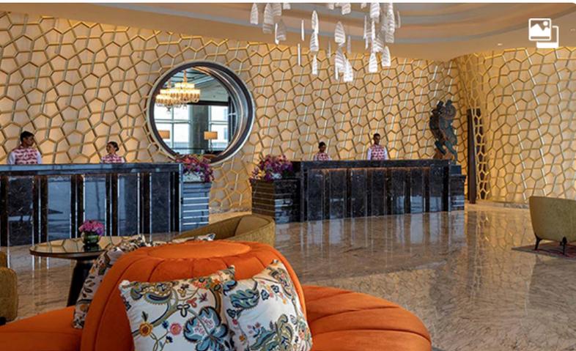
Hotel revenue and optimisation
ITC Hotels, a luxury hospitality brand, manages multiple properties with a range of room categories and varying occupancy rates. The company aims to gain comprehensive insights into its financial performance, customer booking behavior, occupancy patterns, and room category trends to optimize revenue, reduce cancellations, and enhance guest satisfaction. The objective of this project is to develop an interactive, multi-page Power BI dashboard that provides stakeholders with real-time insights for informed decision-making. By analyzing these key metrics, ITC Hotels can refine its business strategies, improve operational efficiency, and elevate the overall customer experience.

Slide 3


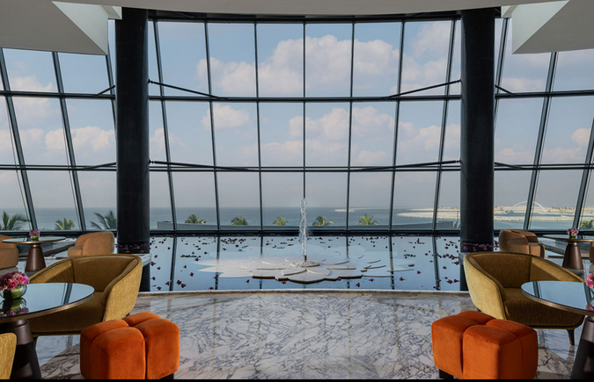

Key Problems
Financial overview
Revenue performance
occupancy and capacity analysis
room category performance & Booking insights
Cancellation and lost revenue

Slide 4
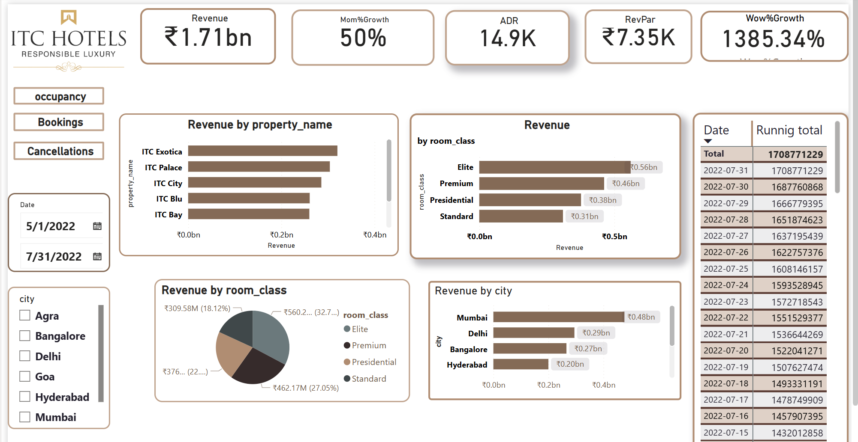

Slide 5

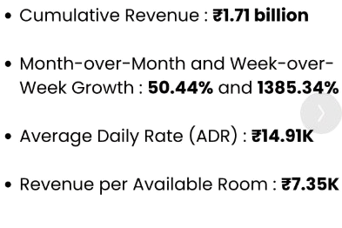
KPI & METRICS:

Slide 6



Date Range Analysis
The data analysis covers the period from May 1, 2022, to July 31, 2022.
Revenue by City
Mumbai generated the highest revenue at ₹3476.27 million (27.87%).
Delhi followed with ₹294.50 million (17.23%).
Bangalore contributed ₹199.94 million (11.7%).
Other cities combined generated ₹192.37 million (11.26%) and ₹154.84 million (9.06%).
Revenue by Type of Day
Weekdays contributed the majority of the revenue, totaling ₹1.18 billion (69.34%).

Slide 7
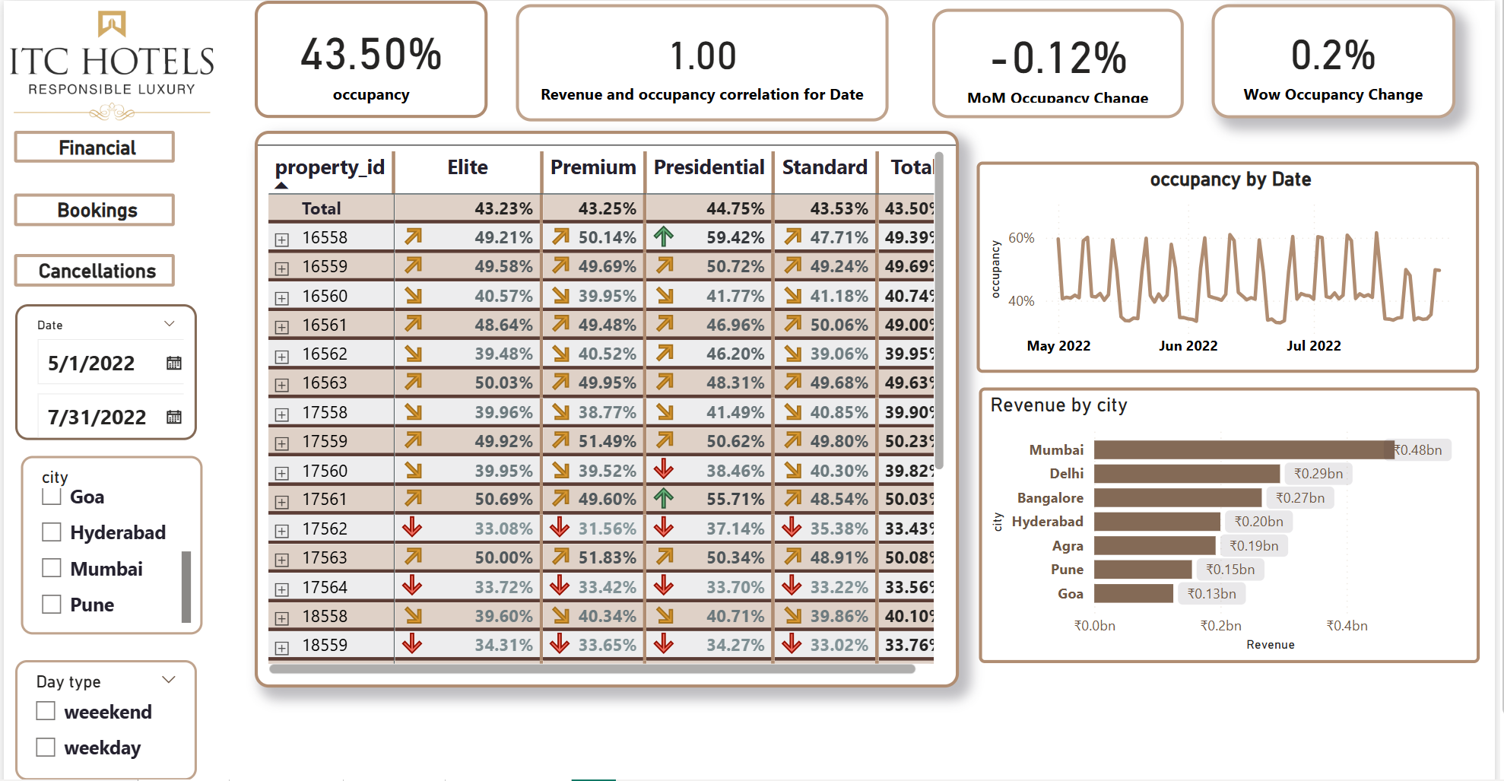

Slide 8
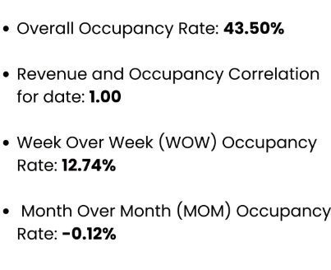
KPI & METRICS:

Slide 9

Occupancy Rates by Property:
ITC Exotica, Agra: 49.69%
ITC Blu, Agra: 50.03%
ITC Grands, Bangalore: 33.50%
ITC Exotica, Bangalore: 40.65%
ITC Bay, Bangalore: 49.80%
ITC Palace, Bangalore: 39.93%
ITC Grands, Delhi: 49.39%
Total Occupancy Rate: 43.50%
Insights:
This analysis highlights the performance of various ITC properties based on their occupancy rates. Properties like ITC Blu, Agra and ITC Bay, Bangalore show strong occupancy rates, suggesting effective management and high demand. In contrast, properties such as ITC Grands, Bangalore and ITC Palace, Bangalore reveal lower occupancy, indicating areas for improvement. City-wise trends show Agra performing consistently well, while Bangalore reflects mixed results. This data allows property managers to identify trends, address underperformance, and implement targeted strategies to improve occupancy and overall efficiency

Slide 10
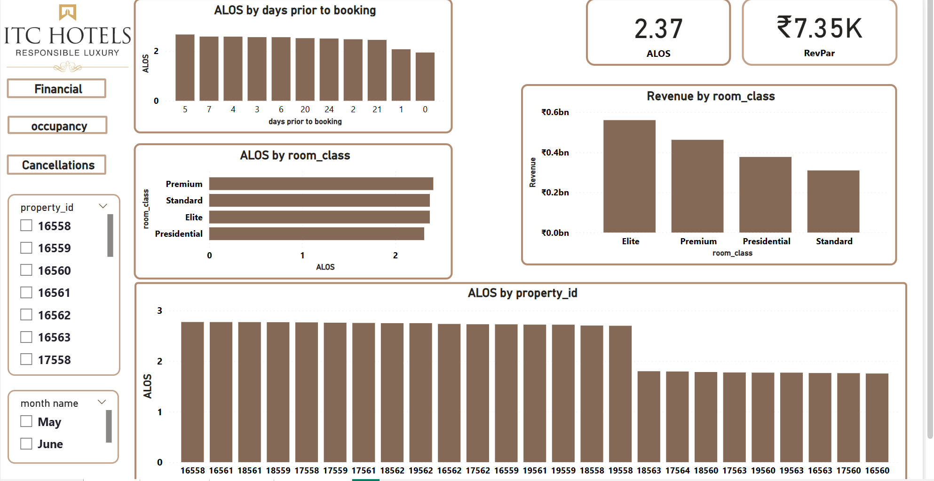

Slide 11
KPI & METRICS:
Average Length of Stay: 2.37 days
Average Time Between Booking and Check-in: 3.71 days

Slide 12

Charts Insights:
Highest revenue by room class: Elite
Highest average length of stay by room class: Premium
Highest average length of stay by property ID: 16558
Highest average length of stay by days prior to booking: 5 days

Slide 13
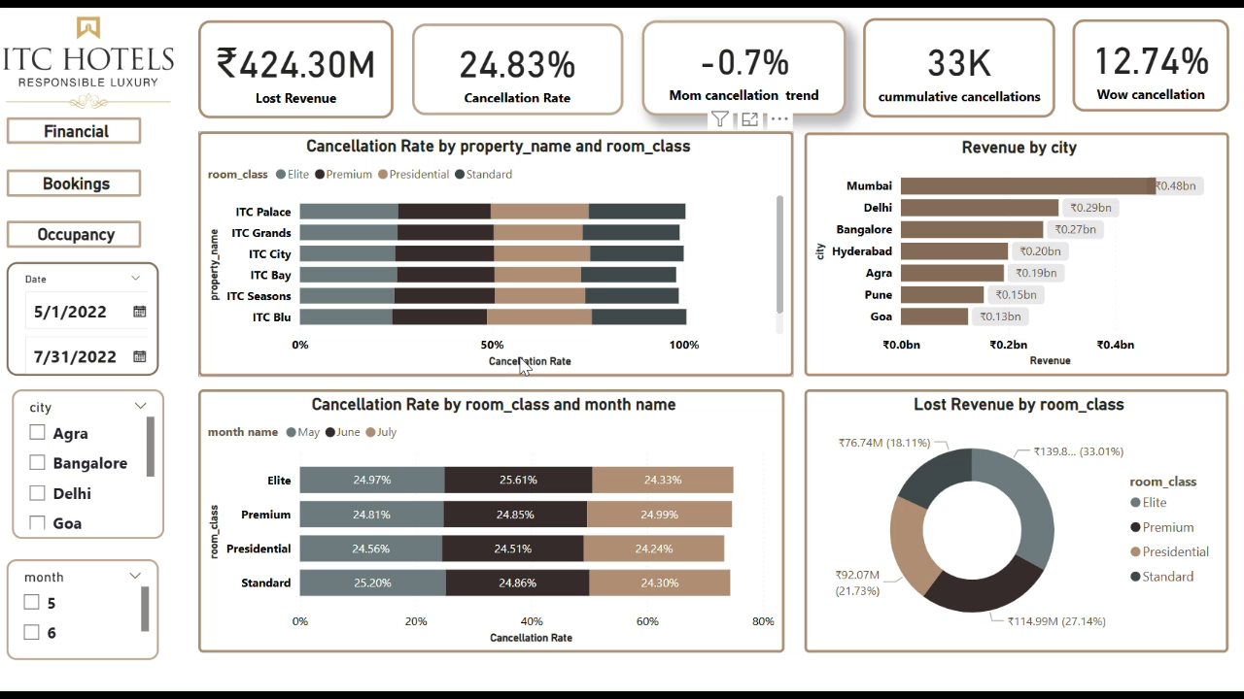

Slide 14
KPI & METRICS:
Cancellation Rate: 24.83%
Cumulative Cancellations: ₹33,000
Lost Revenue Due to Cancellations: ₹424 million
WoW Cancellations: 12.74%
MoM Cancellations: -0.7%

Slide 15
Cancellation Rate by Property Name and Room Class (Bar Chart)
What it shows:
This horizontal bar chart breaks down the cancellation rate for different ITC properties (e.g., ITC Palace, ITC Grands, ITC City) by room class (Elite, Premium, Presidential, Standard).
Insight:
All properties have a high cancellation rate across room classes, with cancellation rates nearing or exceeding 50% for some room classes.
Revenue by City (Bar Chart)
What it shows:
This bar chart displays the total revenue generated by different cities.
Insight:
Mumbai contributes the highest revenue at ₹0.48 billion.
Delhi and Bangalore follow with ₹0.29 billion and ₹0.27 billion, respectively.
Goa generates the lowest revenue among the listed cities (₹0.13 billion).

Slide 16
Cancellation Rate by Room Class and Month (Stacked Bar Chart)
What it shows:
This chart displays the cancellation rates for each room class (Elite, Premium, Presidential, Standard) across three months (May, June, July).
Insight:
Cancellation rates are fairly consistent across all months and room classes.
The Standard room class consistently shows a slightly higher cancellation rate, peaking at 25.20% in May.
Lost Revenue by Room Class (Donut Chart)
Filters and Date Range
What it shows:
Filters allow users to select cities and months for a focused analysis. The dashboard covers the period from May 1, 2022, to July 31, 2022.
Insight:
This dashboard provides a comprehensive view of revenue performance, cancellations, and trends across different properties, cities, and room classes. It helps in identifying patterns that can drive business decisions and improve revenue management.

Slide 17


Thank you
Follow me :
Linkedin:
linkedin.com/in/atikk72

